Slide 1
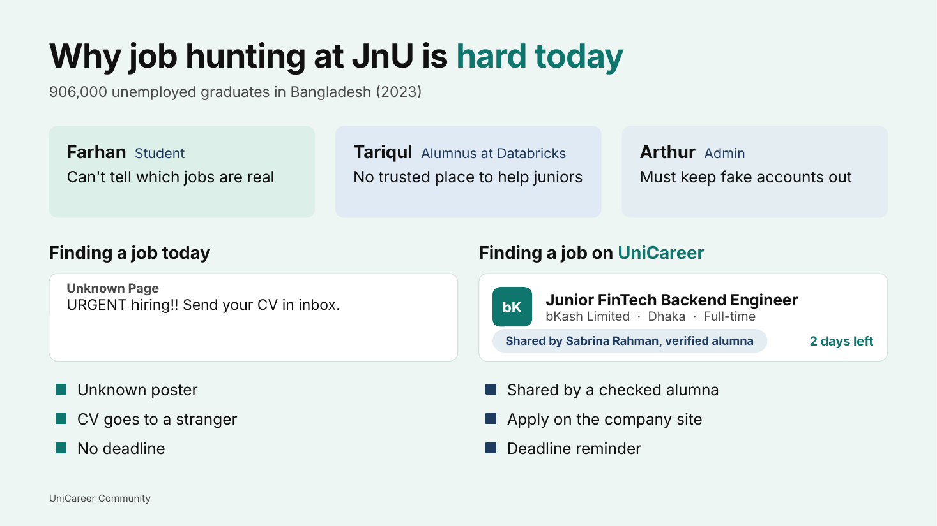

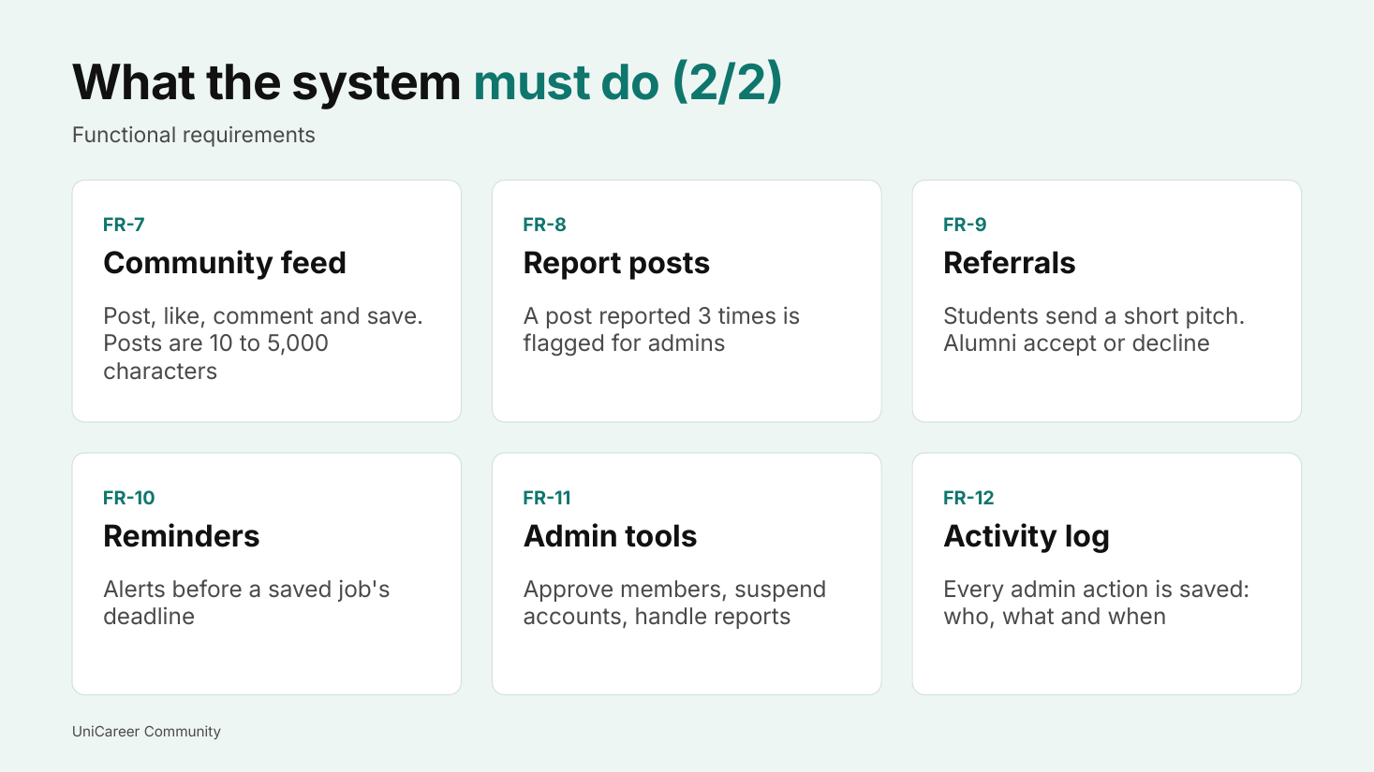
Option 1 · Pale mint + teal
Problem slide (large) · Cover · Requirements

Slide 2
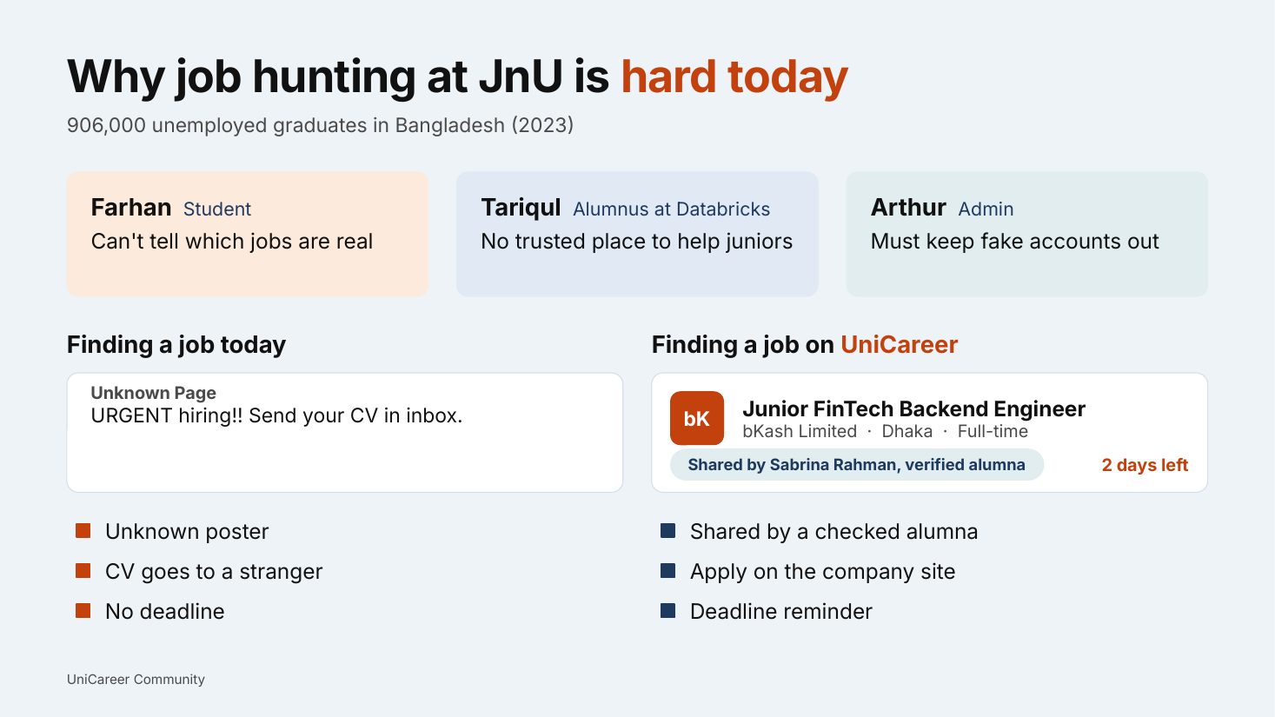

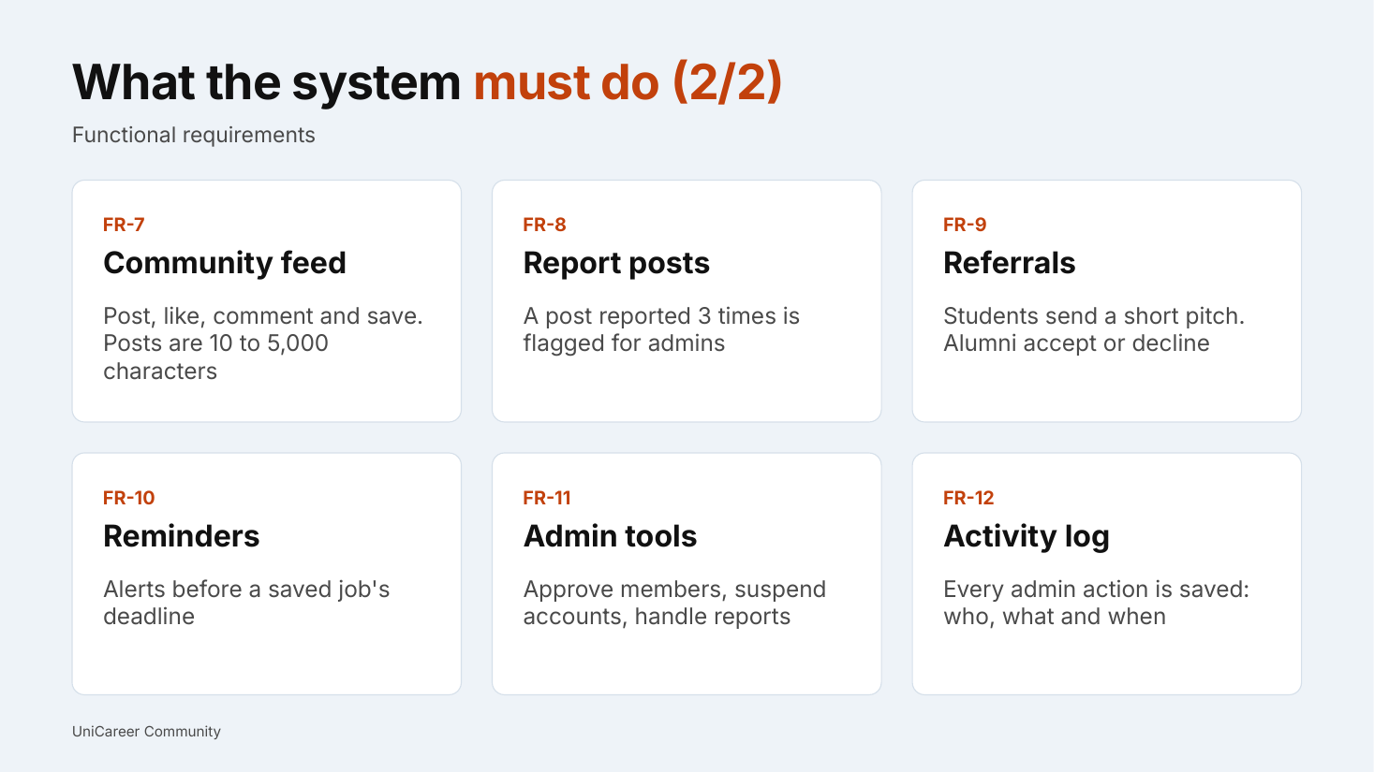
Option 2 · Pale blue + orange
Problem slide (large) · Cover · Requirements

Slide 3
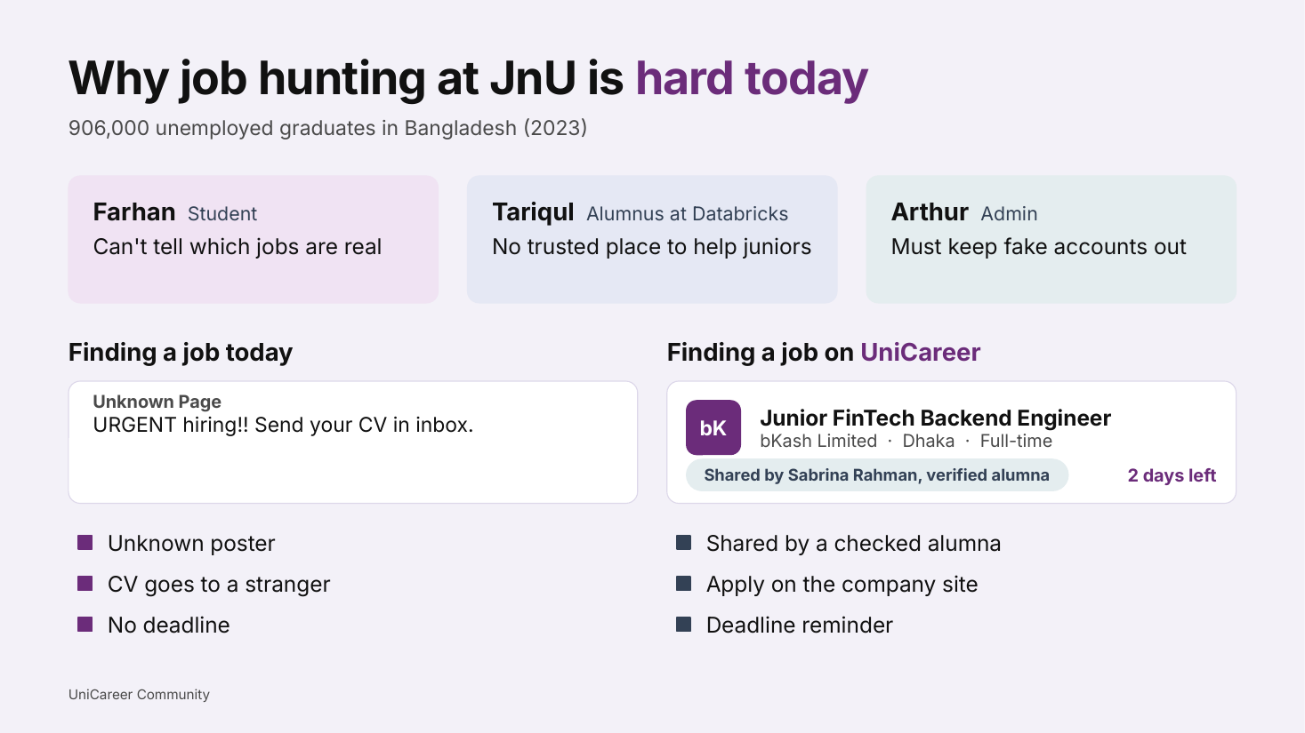

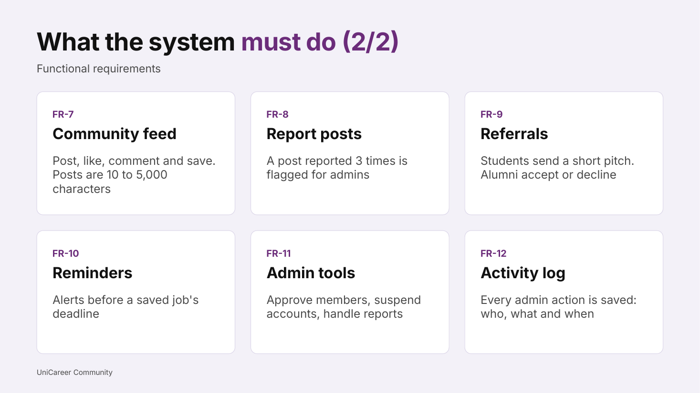
Option 3 · Soft lavender + plum
Problem slide (large) · Cover · Requirements

Slide 4
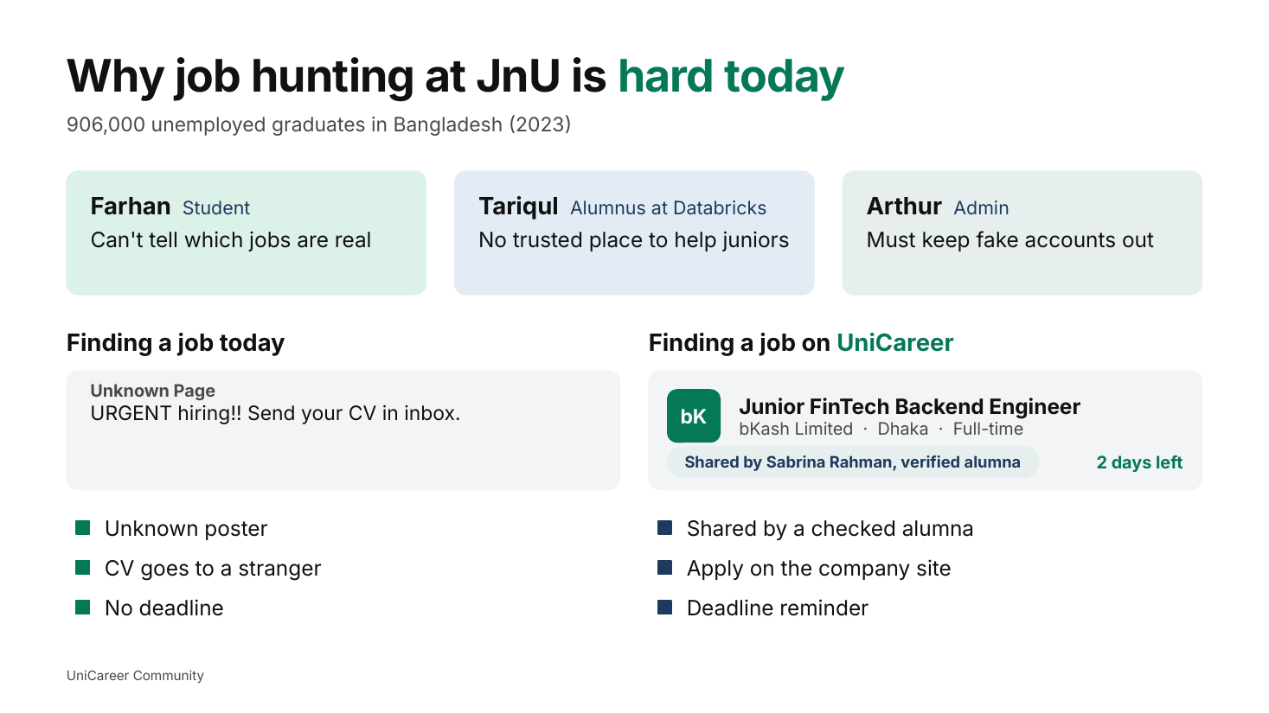

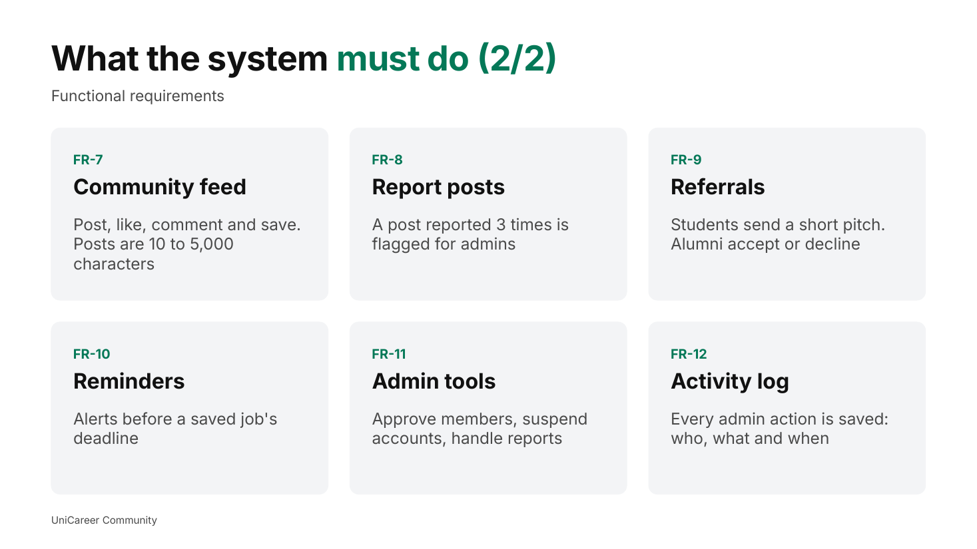
Option 4 · Pure white + emerald
Problem slide (large) · Cover · Requirements

